Slide 1
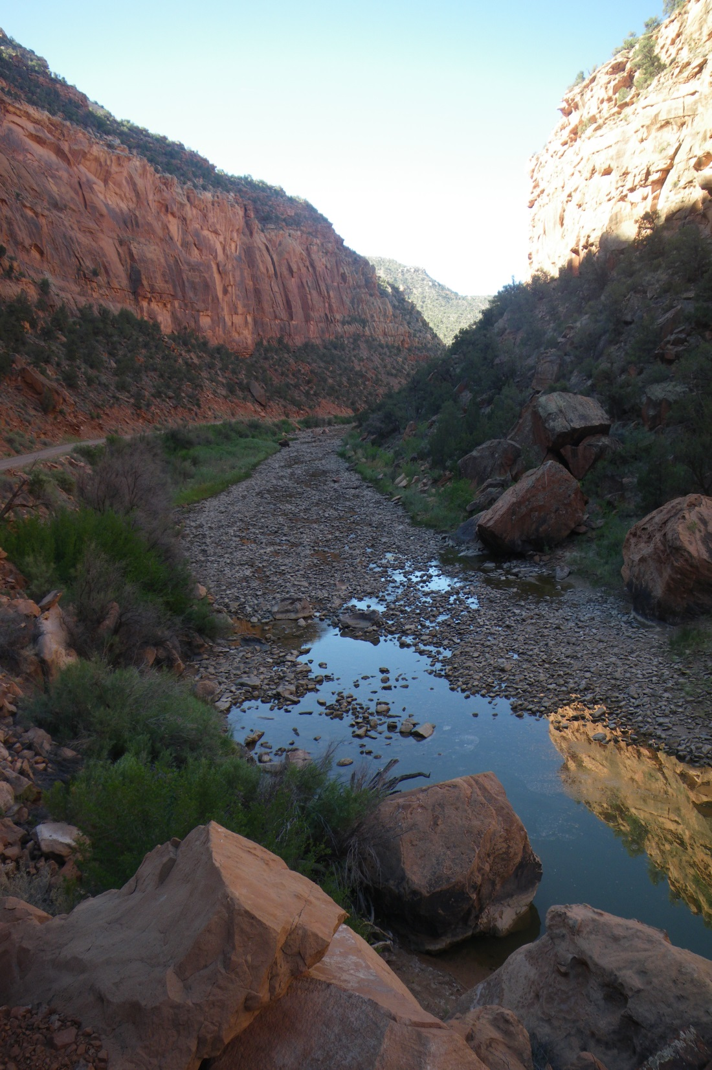
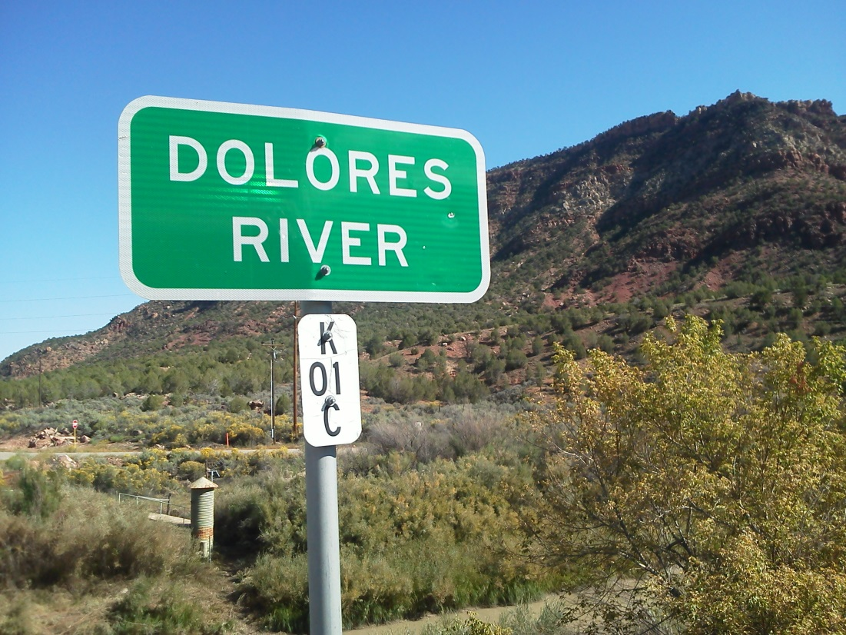
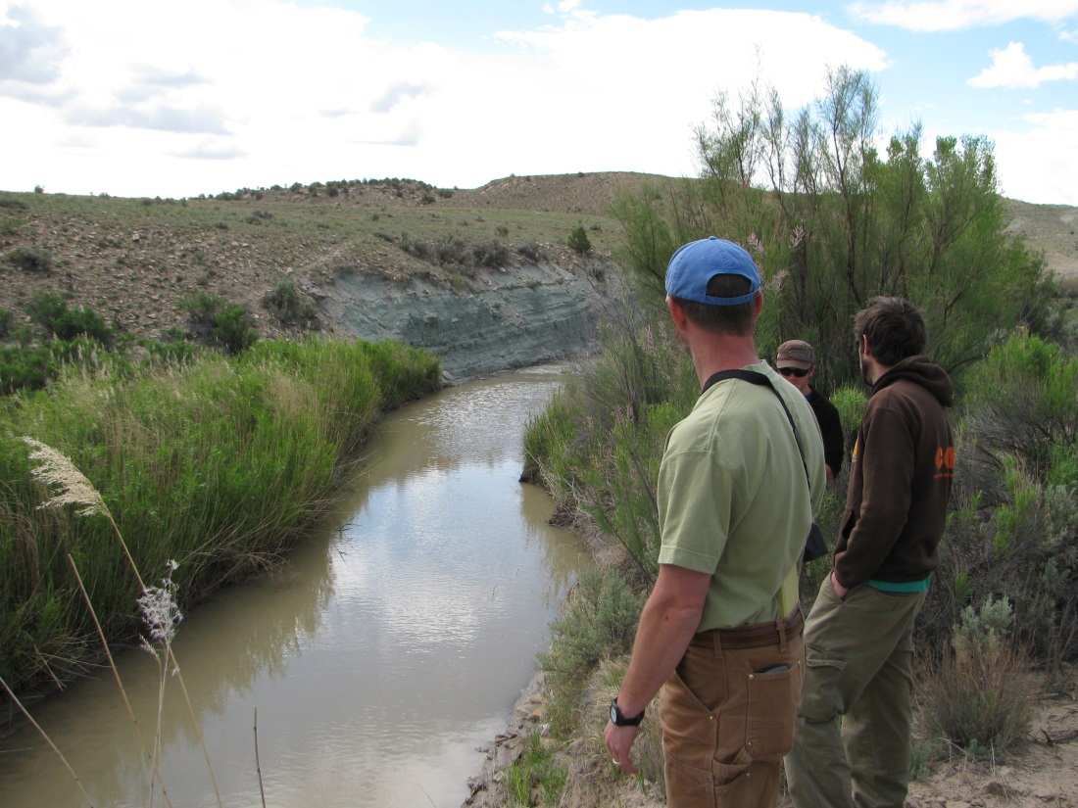
Implementation Monitoring and Evaluation Plan for Native Fish
Tres Rios Field Office, October 28th 2014

Slide 2
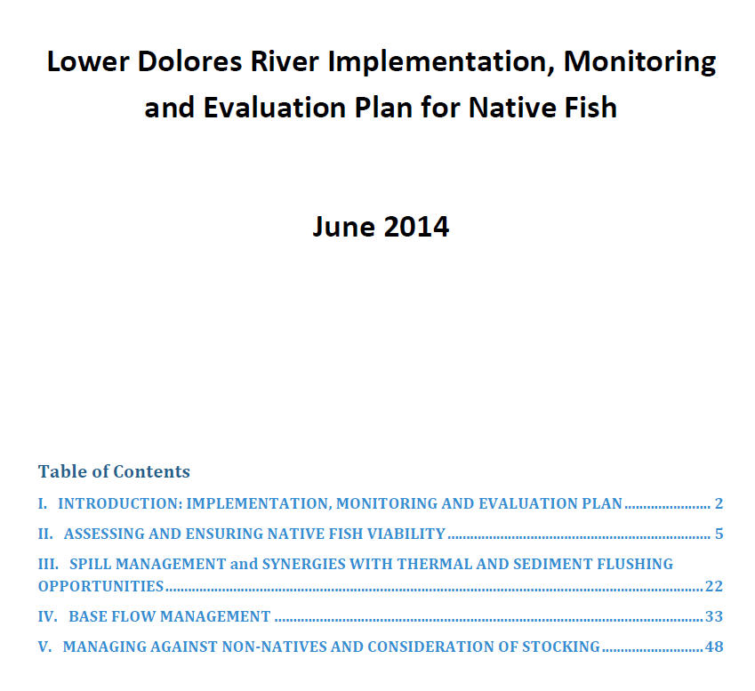
Revised Plan
What changes were made in revised Plan?

Slide 3
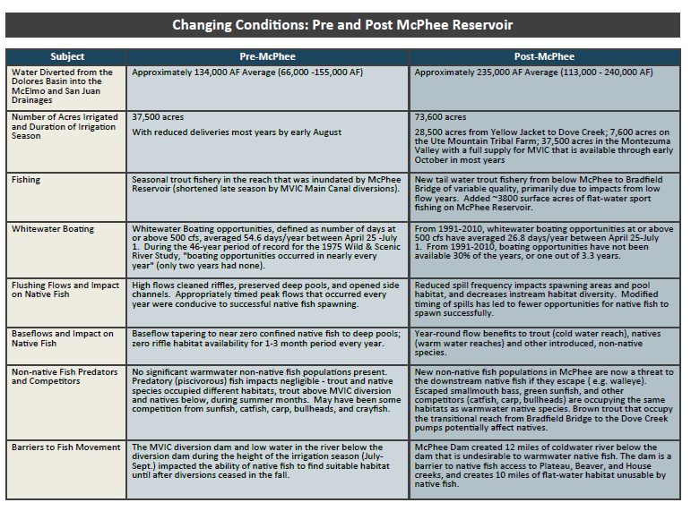
The Challenges hydrology, timing, volume, duration of spills

Slide 4
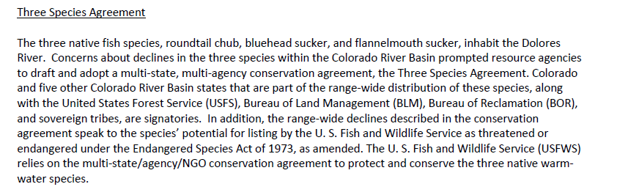
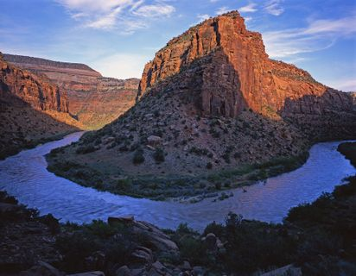
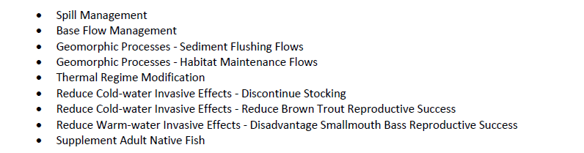
9 opportunities to benefit native fish

Slide 5
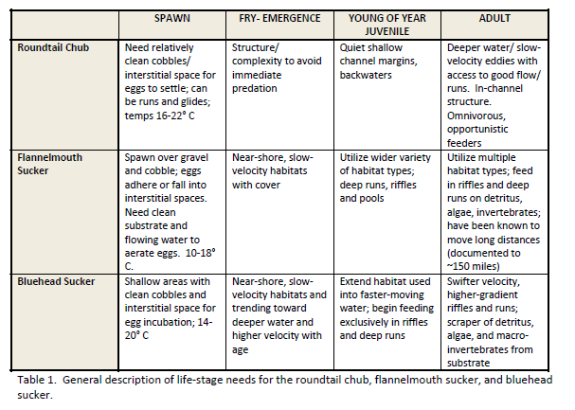
Breaking down native fish needs with Habitat capacity

Slide 6
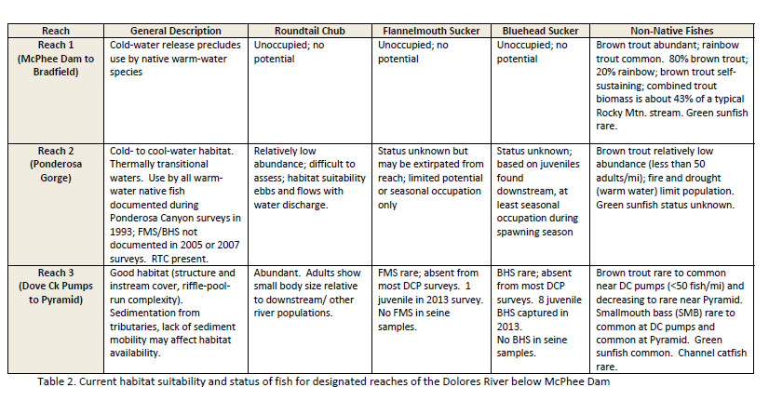
Native Fish link to Dolores River reaches

Slide 7
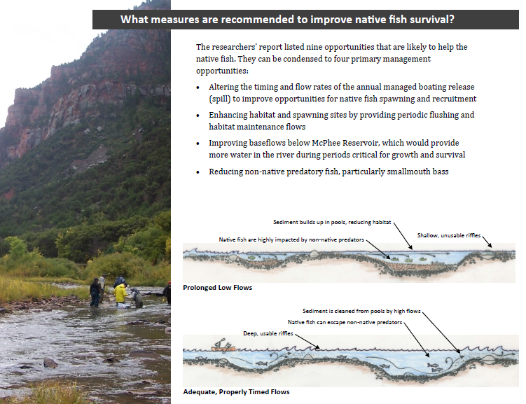

Slide 8
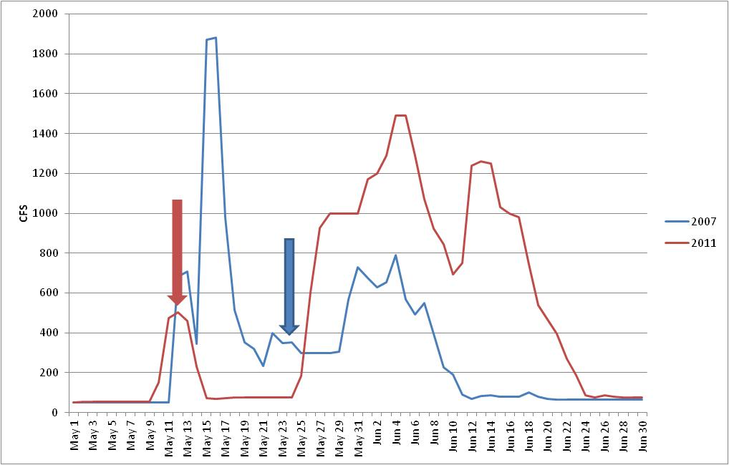
Dolores River Discharge Conditions During 2007 and 2011
While peaking flows are helpful for riparian health, the rates of decline are often precipitous and may not advance cottonwood recruitment

Slide 9
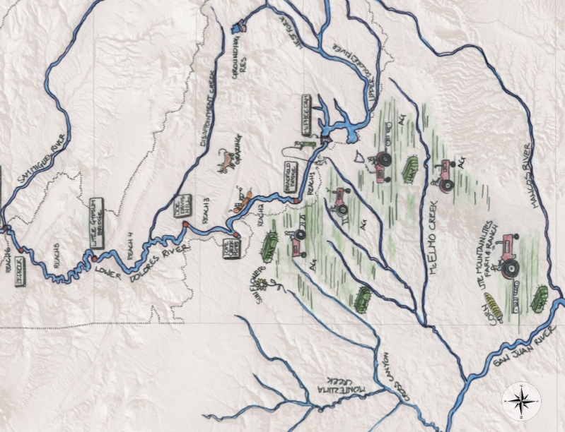
Linkage: farming & ranching recreation native fish riparian health

Slide 10
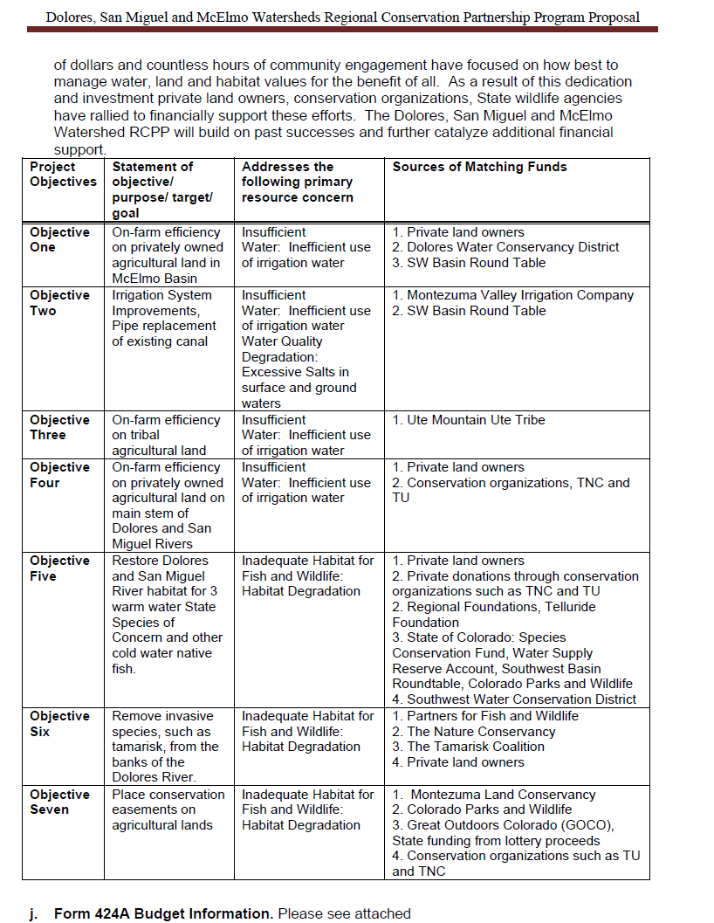
Opportunity: NRCS, RCPP

Slide 11
RANGE-WIDE
CONSERVATION AGREEMENT AND STRATEGY FOR
ROUNDTAIL CHUB Gila robusta,
BLUEHEAD SUCKER Catostomus discobolus,
AND FLANNELMOUTH SUCKER Catostomus latipinnis
Prepared for
Colorado River Fish and Wildlife Council
Prepared by
Utah Department of Natural Resources
Division of Wildlife Resources
1594 West North Temple, Suite 2110
P.O. Box 146301
Salt Lake City, Utah 84114-6301
James F. Karpowitz
Director
Publication Number 06-18
September 2006
Signatories Include:
6 States
BOR, USFS, BLM
Tribes

Slide 12
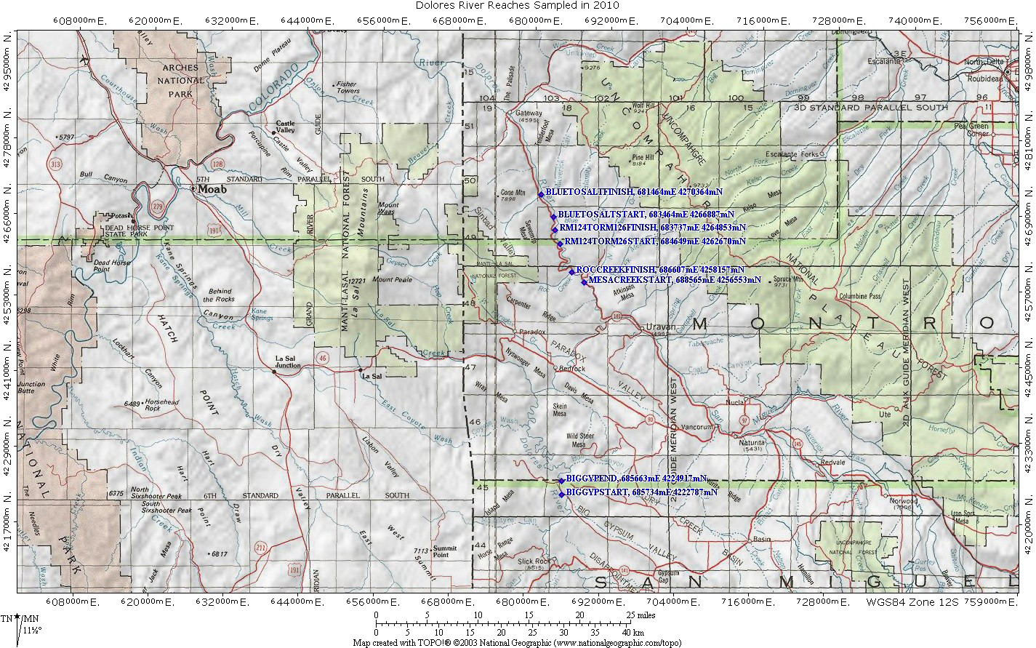

Slide 13
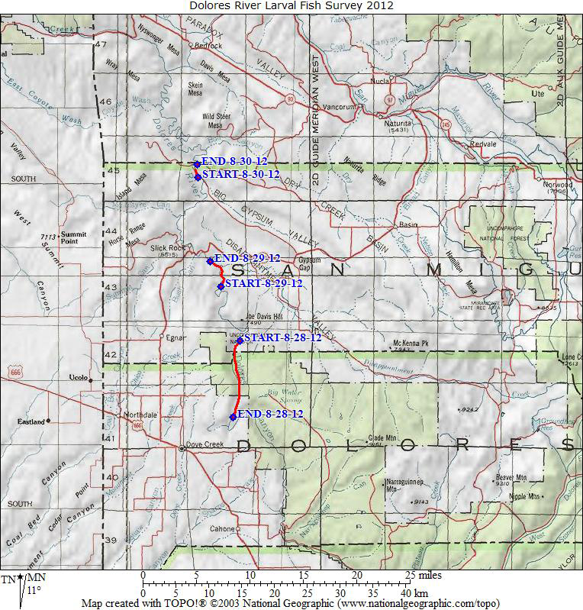

Slide 14
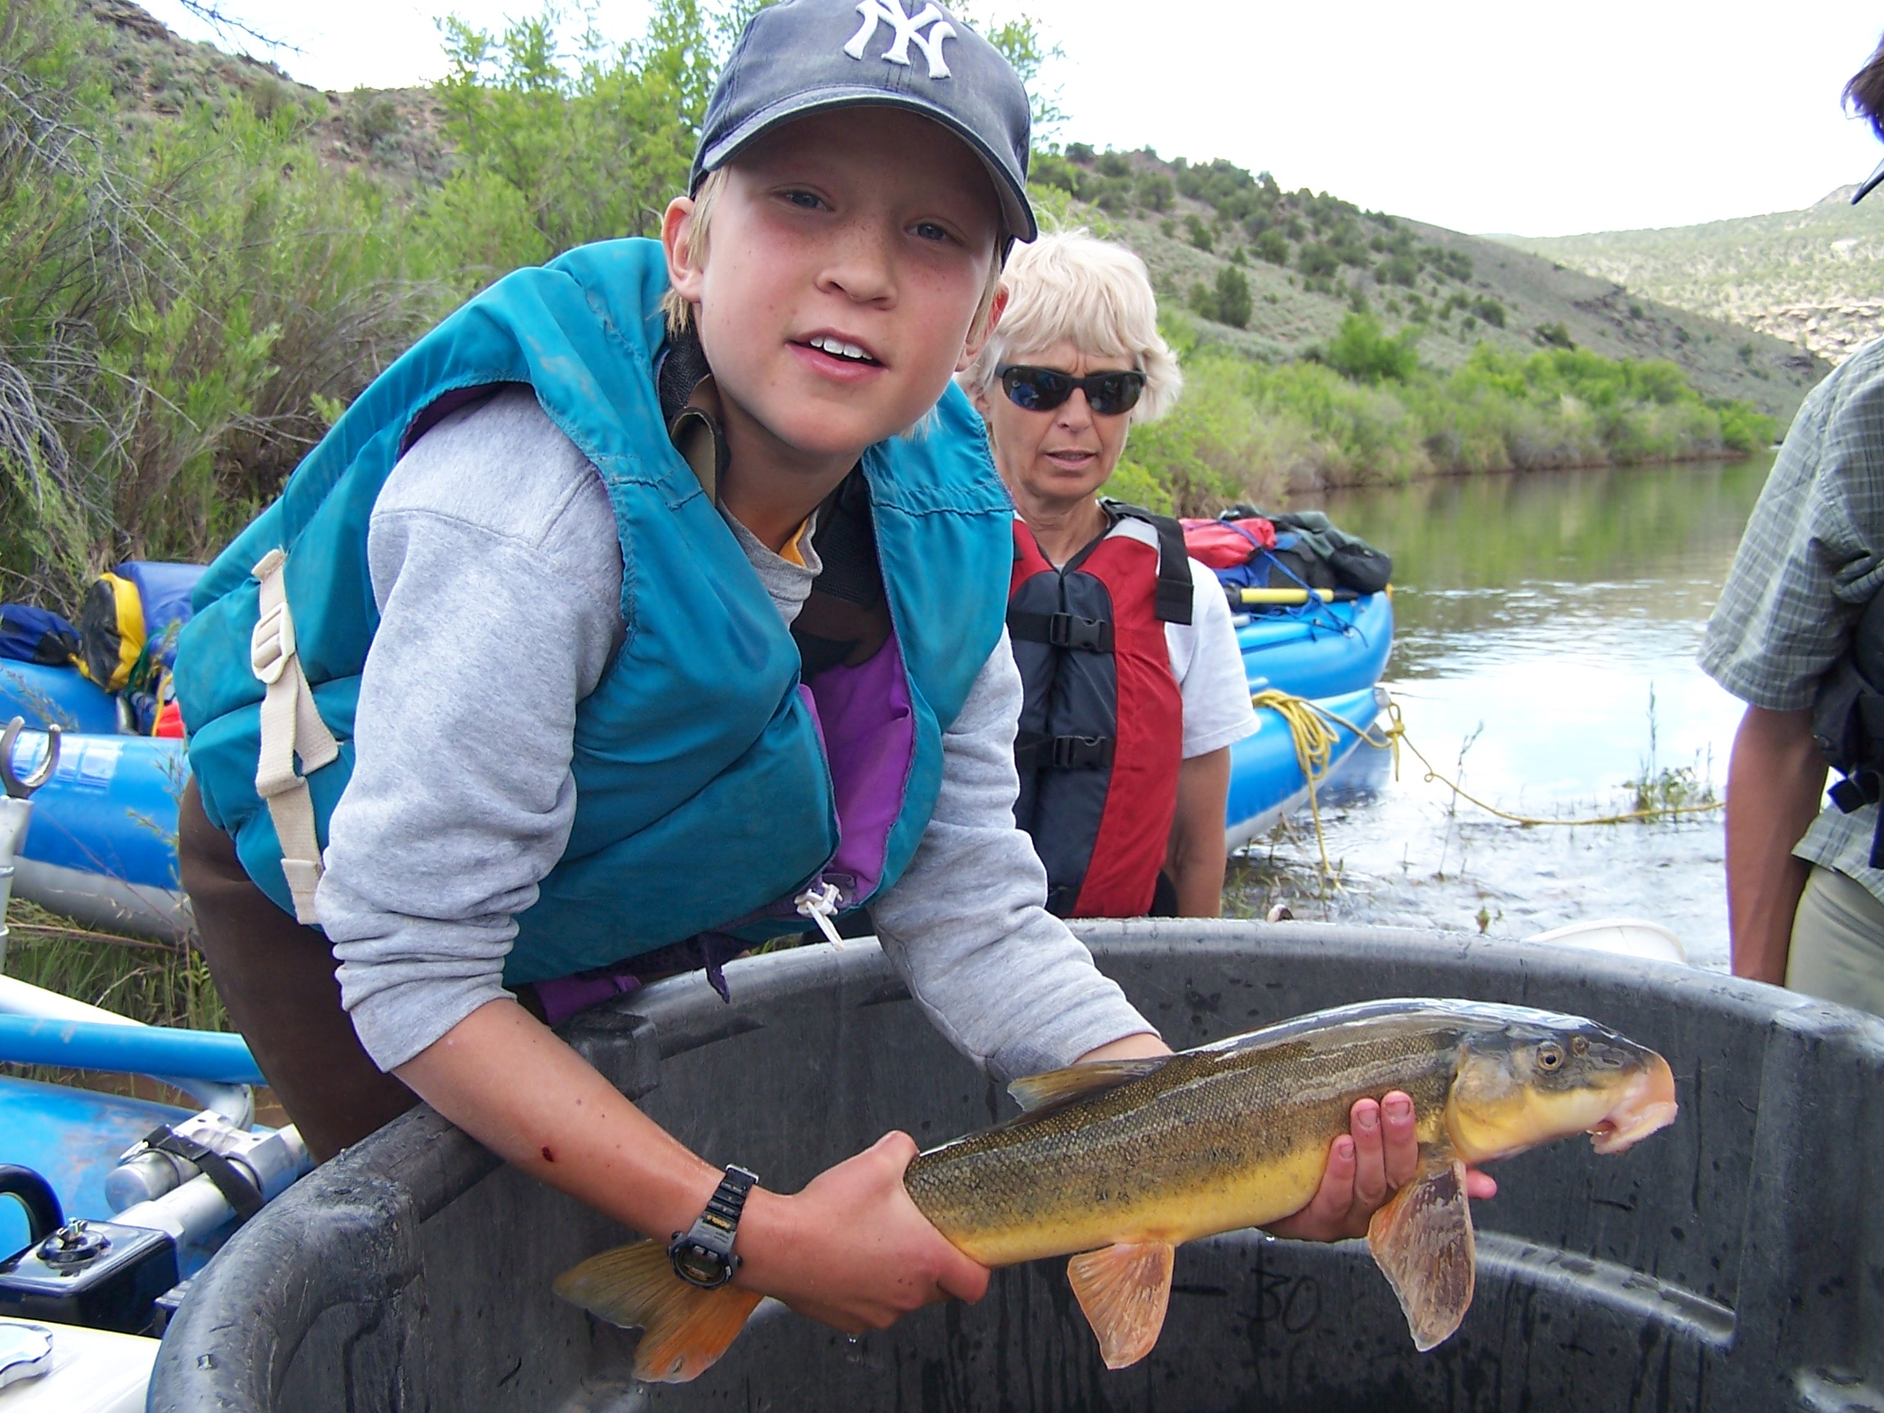

Slide 15
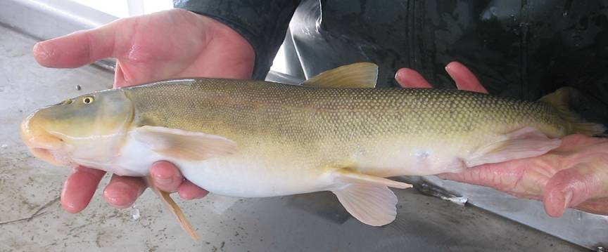

Slide 16
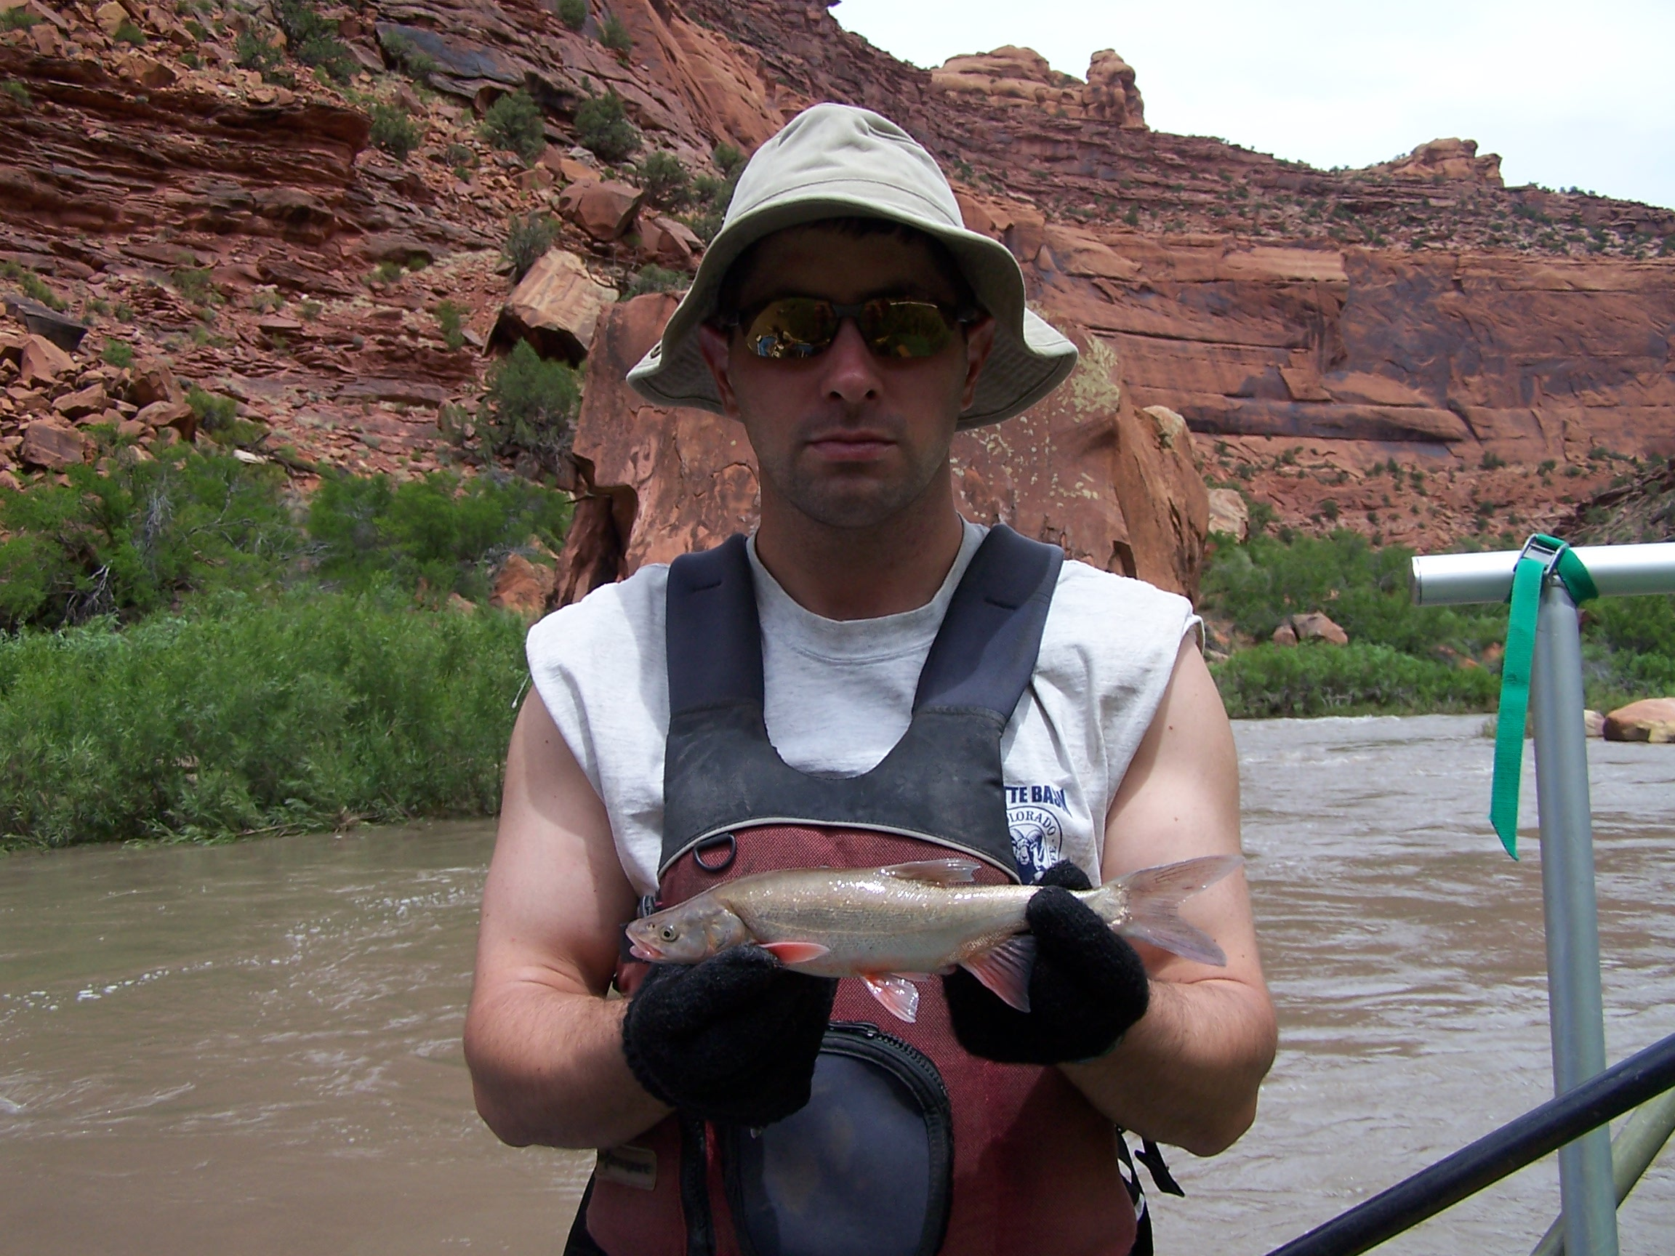

Slide 17
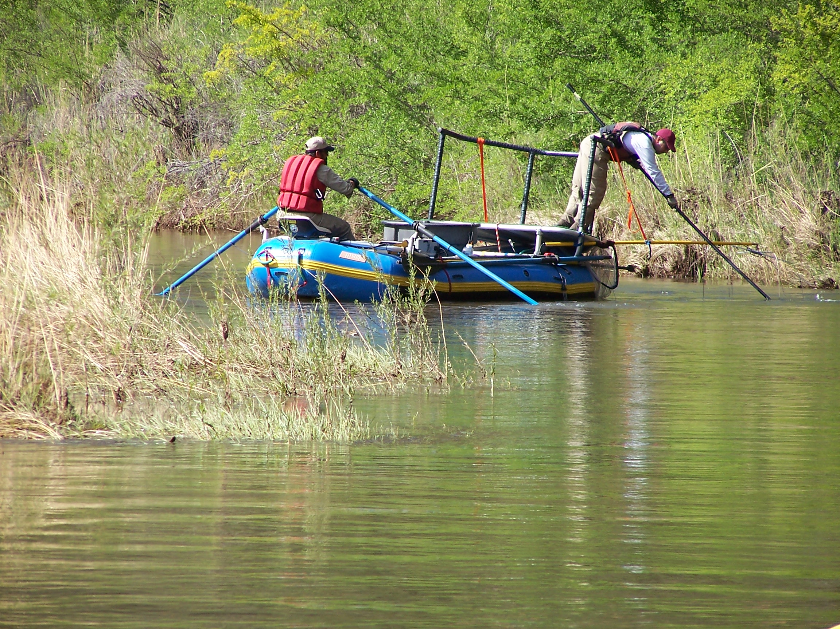

Slide 18
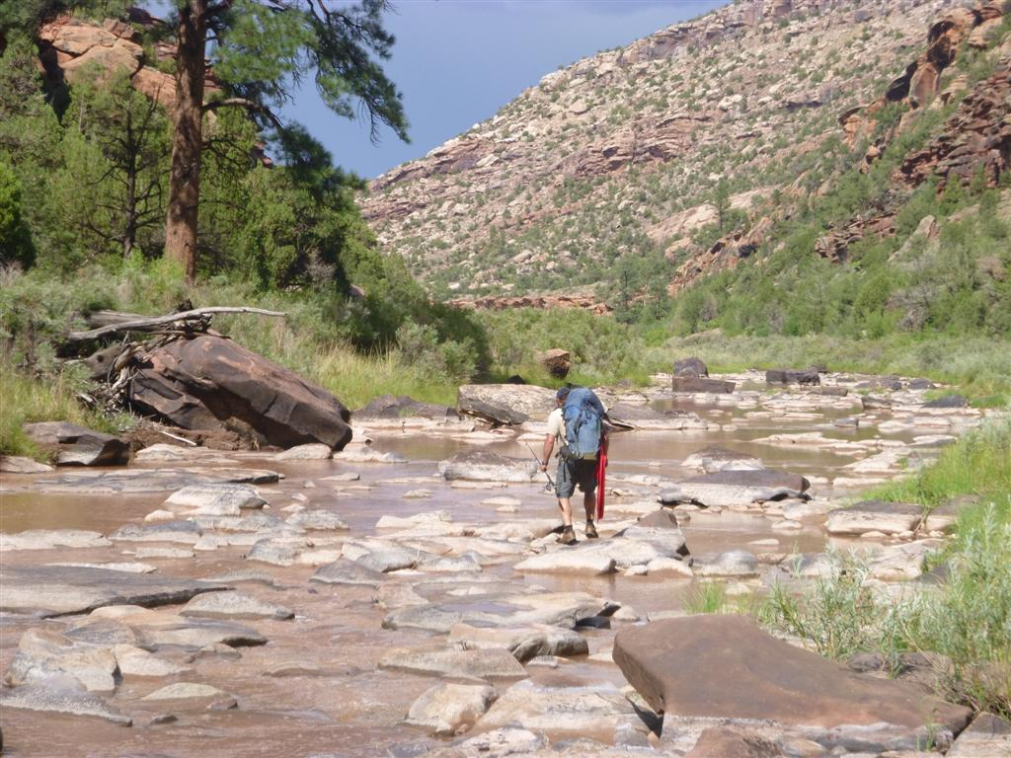

Slide 19
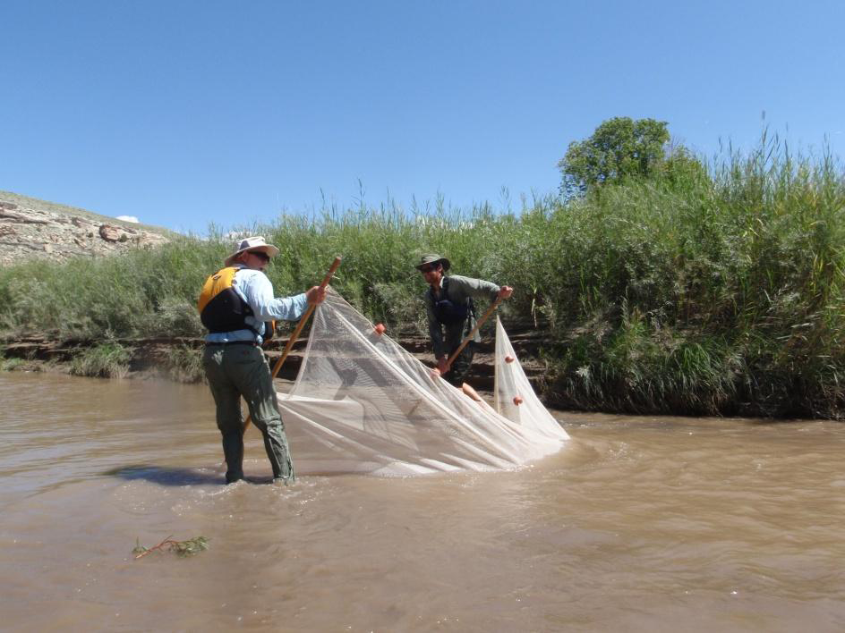

Slide 20
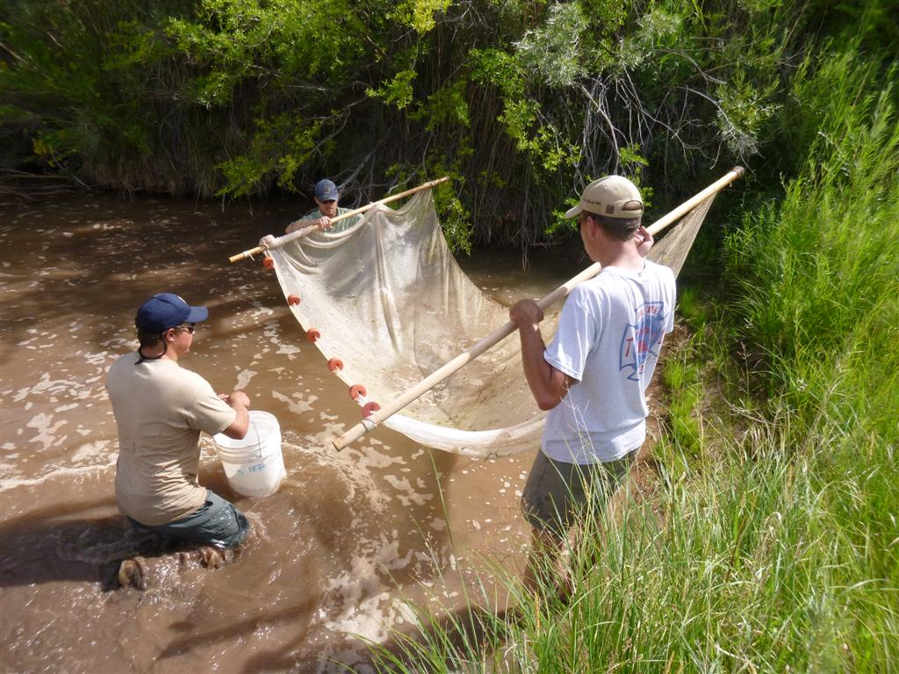

Slide 21
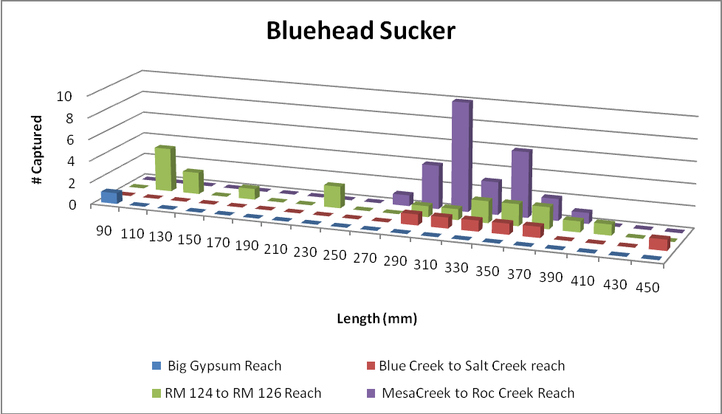

Slide 22
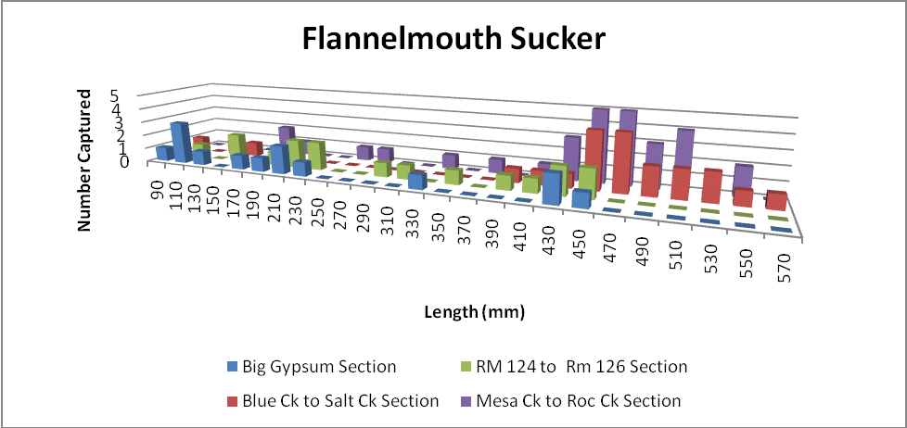

Slide 23
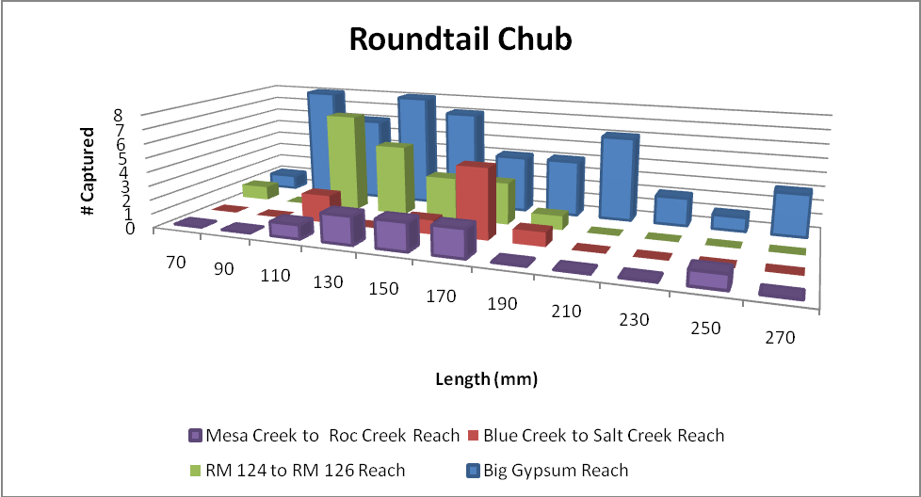

Slide 24
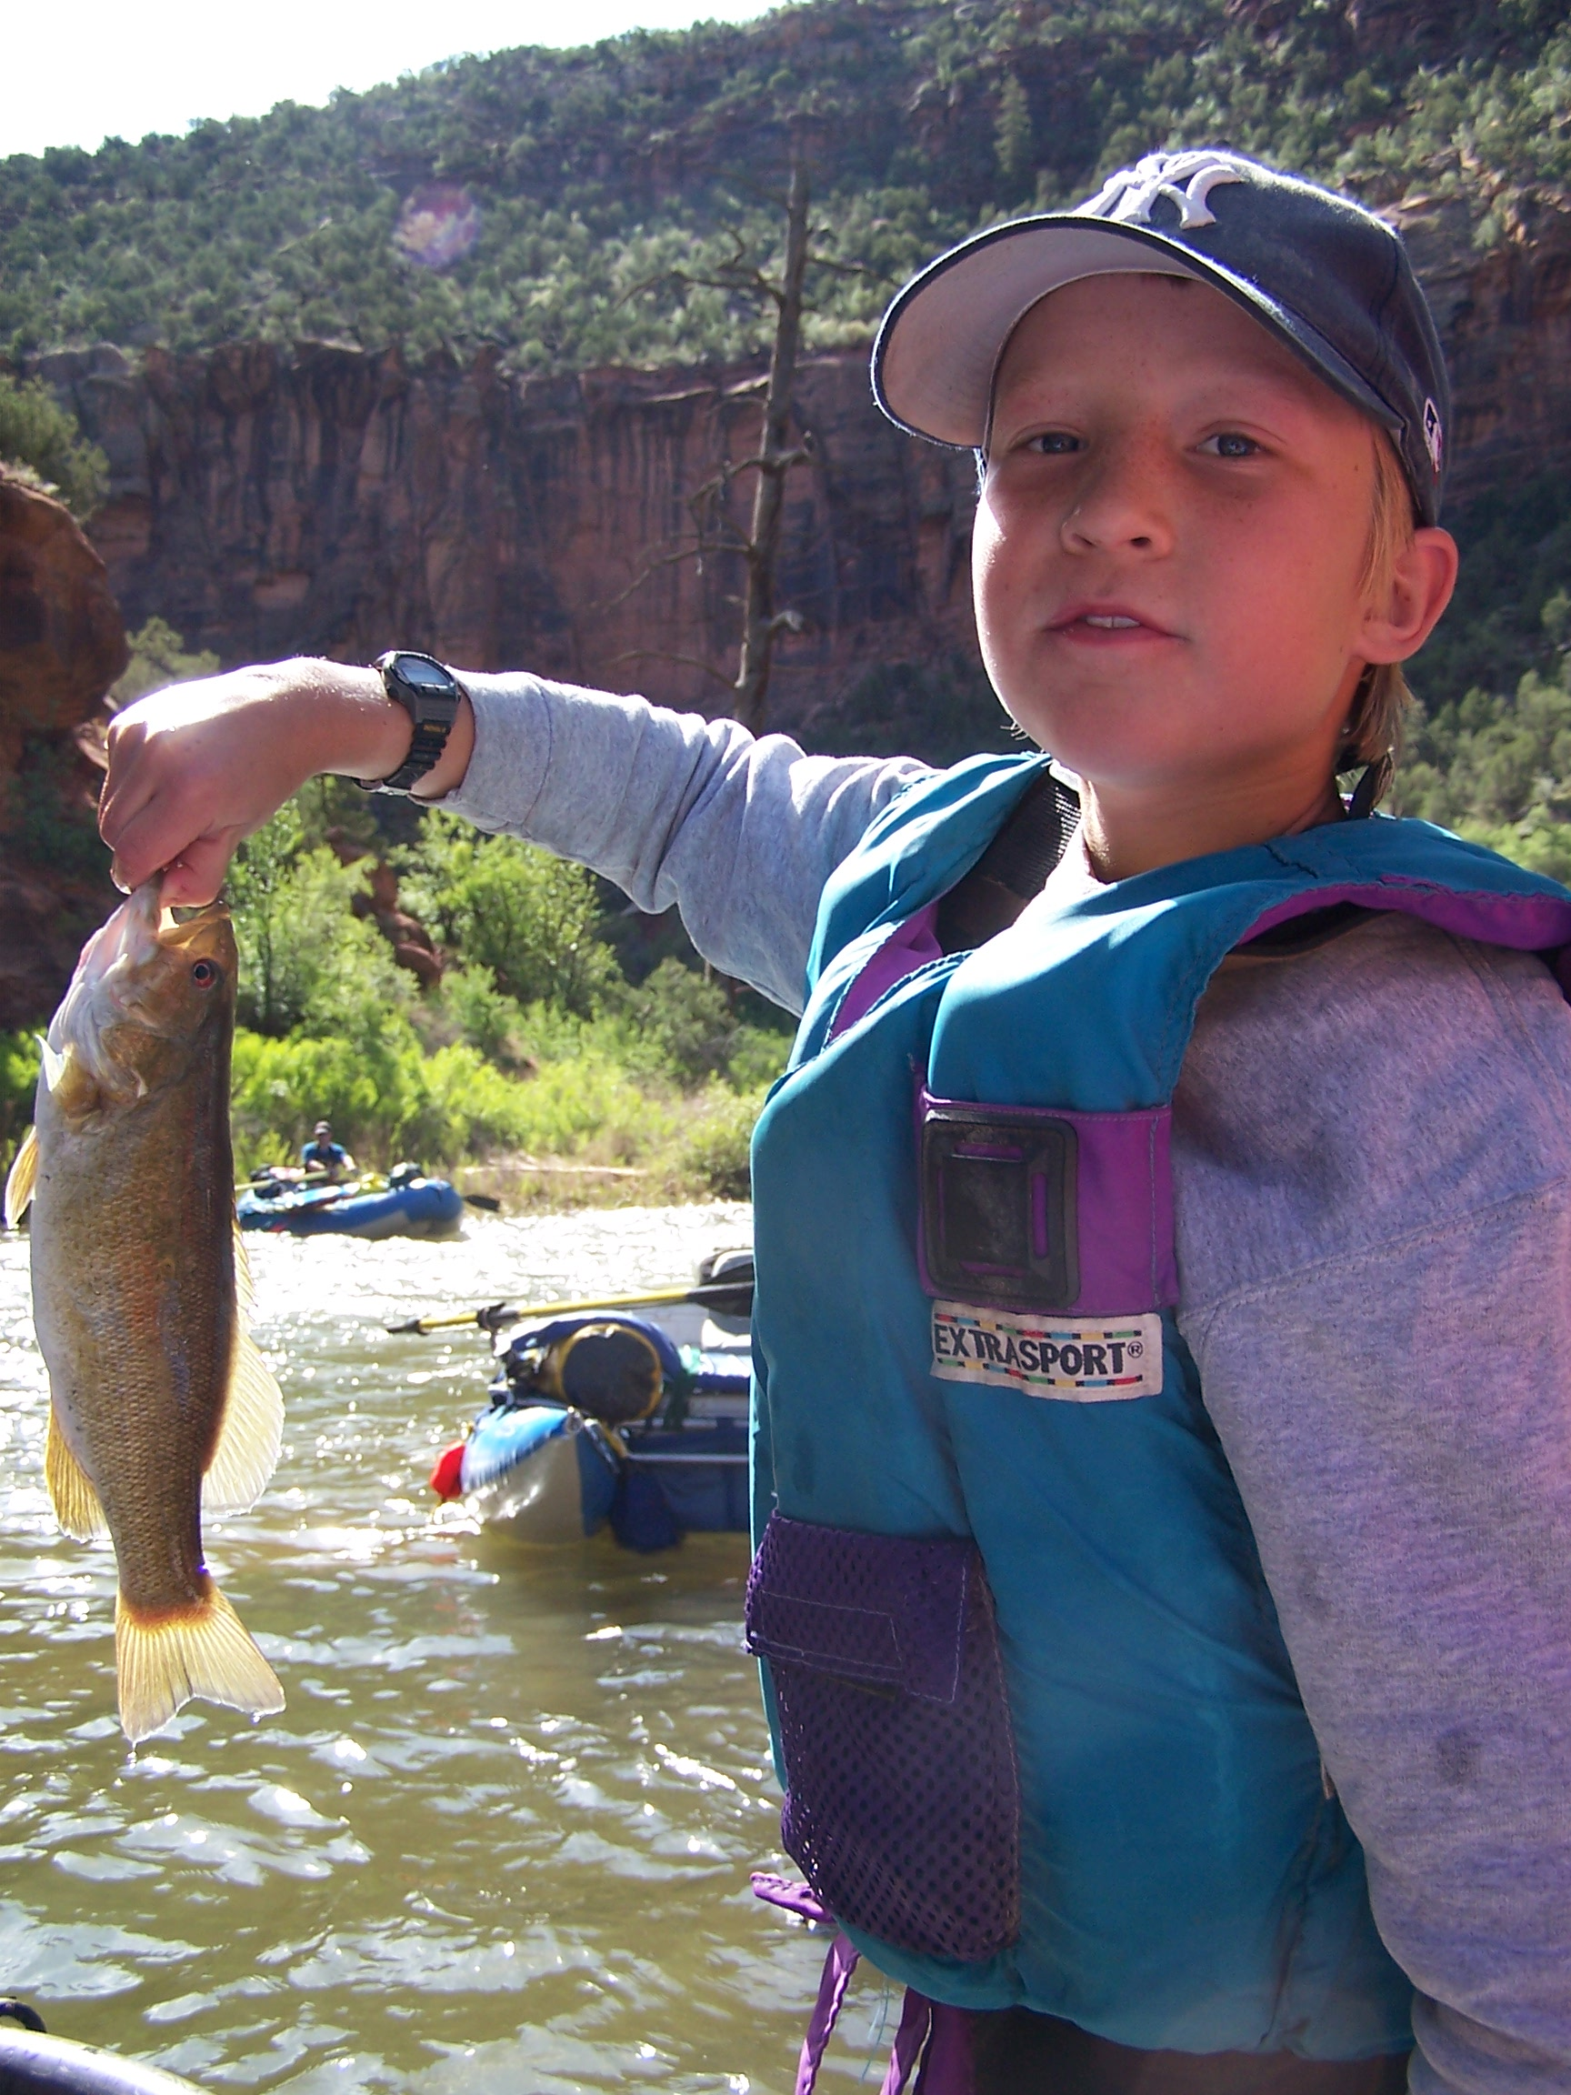

Slide 25
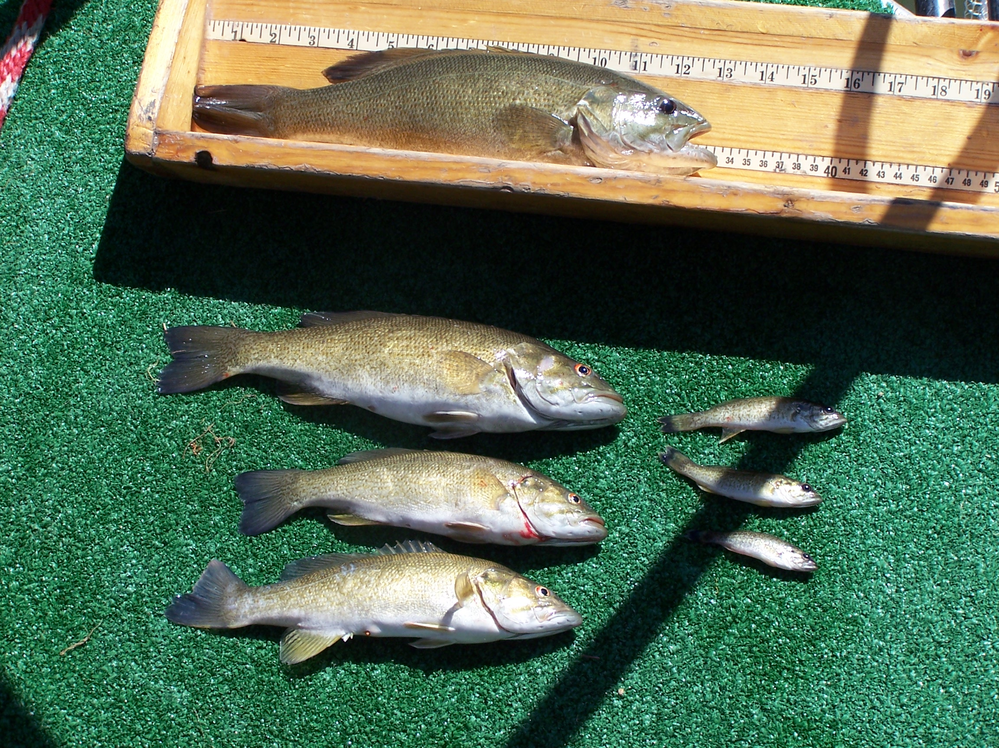

Slide 26
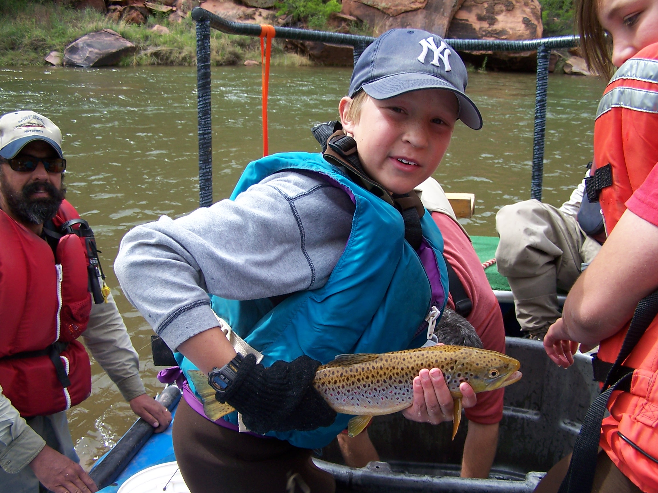

Slide 28
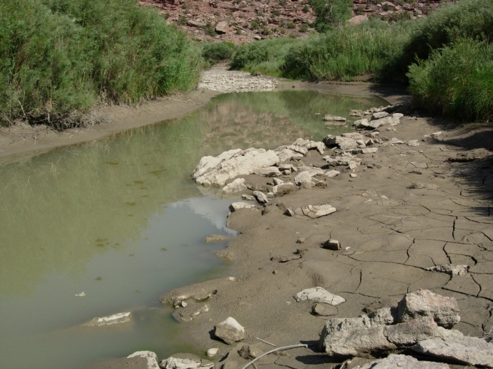

Slide 29
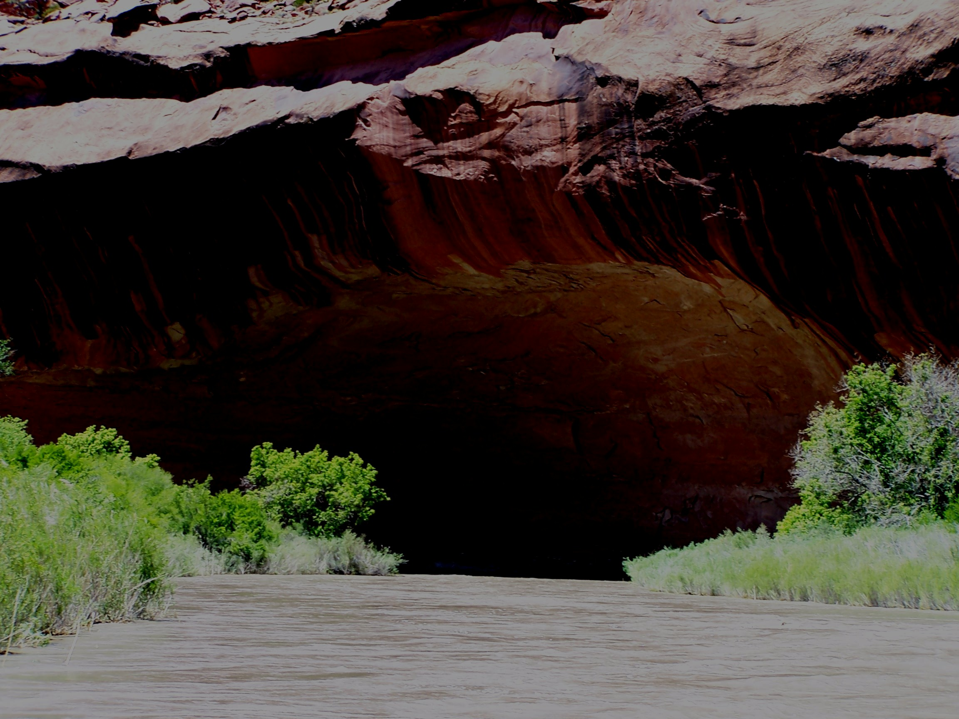

Slide 30
Critical Questions for Discussion
How might the 9 opportunities to benefit native fish, benefit efforts to restore riparian habitat?
What, if any, additional information do we need to provide for native fish and riparian health?
How can we coordinate our planning, implementation and monitoring work, when necessary?
Habitat - Are there areas where habitat manipulation would advance riparian and native fish goals?
  What is the criteria?
  Who would best plan, fund and implement this work?
Reservoir releases - Can we correlate riparian flow needs with native fish?

